Slide 1
Digital Portfolio
STUDENT NAME: V.JEYA PRAKASH NARAYANAN
REGISTER NO AND NMID: 222403595 & 21ECODBFD73B58B944F4794A8485F4E2
DEPARTMENT : BSC COMPUTER SCIENCE WITH ARTIFICIAL INTELLEGENCE
COLLEGE : SRIDEVI ARTS AND SCIENCE COLLEGE
UNIVERSITY : MADRAS UNIVERSITY

Slide 2
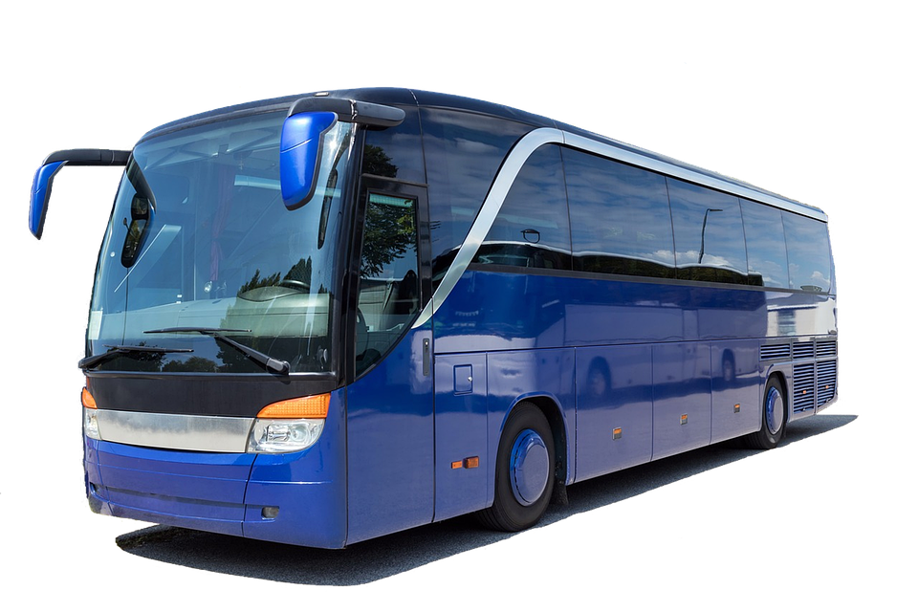
Project Title
Bus Ticket Booking System

Slide 3
Agenda
1. Problem Statement
2. Project Overview
3. End Users
4. Tools and Technologies
5. Portfolio Design and Layout
6. Features and Functionality
7. Results and Screenshots
8. Conclusion
9. Github Link

Slide 4
Problem Statement
Manual bus ticket booking is time-consuming, requires physical presence, and lacks flexibility. There is a need for a digital platform to simplify and speed up the process.

Slide 5
Project Overview
The Bus Ticket Booking System is an application that allows users to search buses, select seats, and book tickets online with ease. It ensures convenience, time-saving, and efficient management of bookings.

Slide 6
End Users
- Passengers who want to book tickets online
- Bus operators managing seat availability
- Admin for maintaining system data

Slide 7
Tools and Technologies
- Frontend: Android / Flutter
- Backend: Node.js / Java / Python
- Database: MySQL / Firebase
- Tools: VS Code, GitHub

Slide 8
Portfolio Design and Layout
The system is designed with a simple and user-friendly UI:
- Login/Signup Page
- Search Bus Page
- Seat Selection Page
- Ticket Confirmation Page

Slide 9
Features and Functionality
- Easy login and signup
- Search for buses by source and destination
- Seat availability check
- Online booking and confirmation
- User-friendly design

Slide 10
Results and Screenshots
Screenshots of the application:
- Bus booking form
- Seat selection
- Ticket confirmation

Slide 11
GITHUB LINK
https://github.com/jayPrakash0210/TNDSC-FWD-DP1.git

Slide 12
Conclusion
The Bus Ticket Booking System provides a digital solution for passengers, offering convenience and saving time. Future improvements may include payment gateway integration and live bus tracking.

